Slide 1



Development of the Failure Criteria for Composites
Associate Professorship of Computational Mechanics and Professorship of Wood Technology
Department of Civil, Geo and Environmental Engineering
Technical University of Munich
Software Lab Project 2019 (Group #11)
2nd Review Presentation
Group members:
Panagiotis Gavallas, Yasuyuki Shimizu, Ammar Khallouf
Project Supervisors:
Ani Khaloian
Michael Richter
Prof. Fabian Duddeck (Computational Mechanics Group)
Munich, 23. July 2019

Slide 2
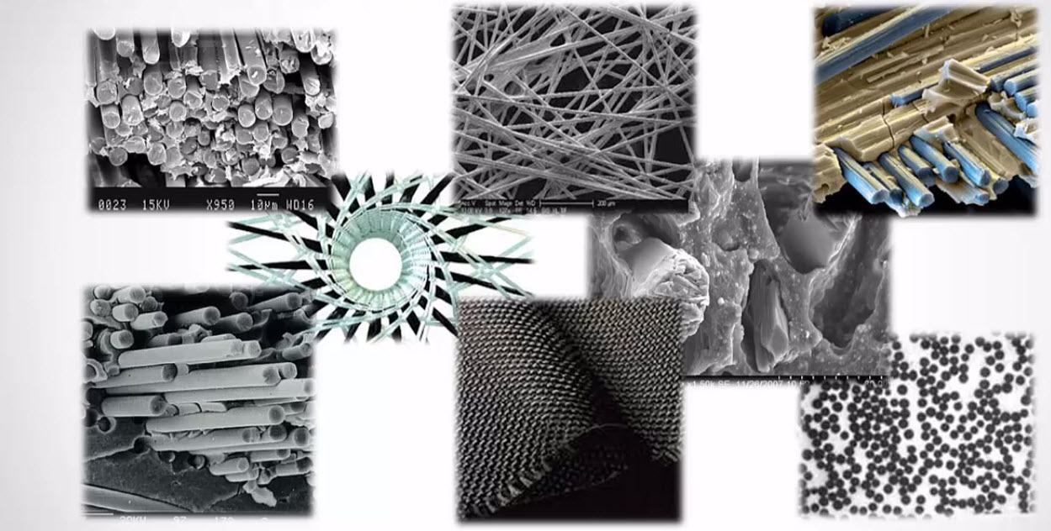
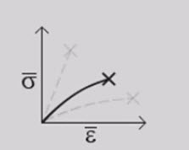
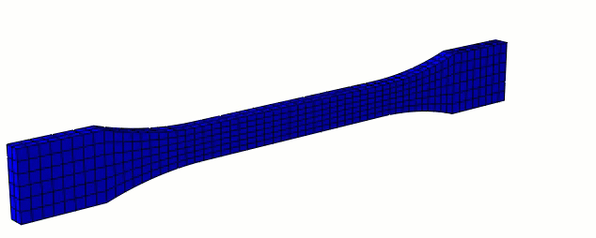
Associate Professorship of Computational Mechanics and Professorship of Wood Technology
Department of Civil, Geo and Environmental Engineering
Technical University of Munich
Overview and Motivation
Development of UMAT
UMAT Scheme Implementation
UMAT Application Example
Current Progress and Future Timeline
Software Lab Project 2019 | Development of Failure Criteria for Composites | 2nd Review
2

Slide 3
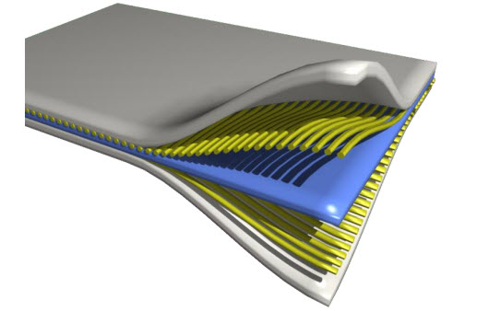
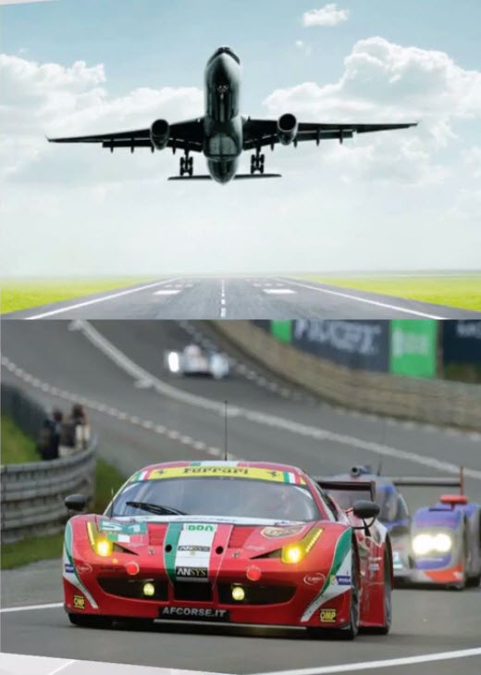
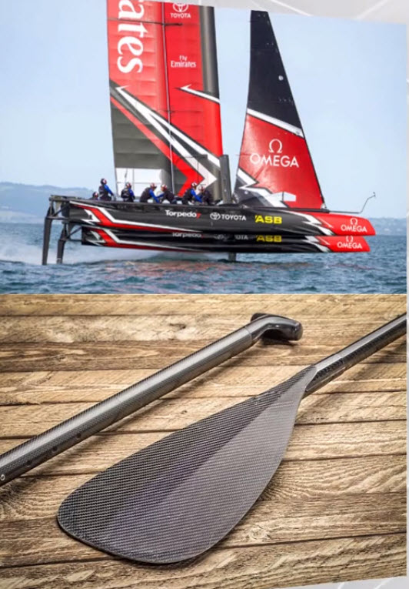
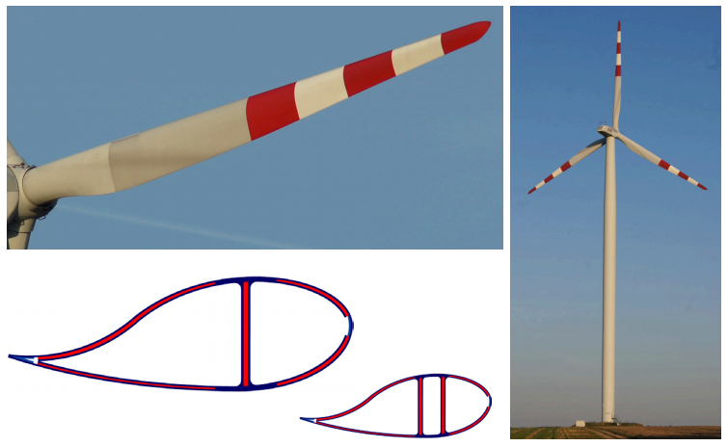
Overview and Motivation
Associate Professorship of Computational Mechanics and Professorship of Wood Technology
Department of Civil, Geo and Environmental Engineering
Technical University of Munich
Why Composite materials ?
High Strength, Low Weight
Durability
Design Flexibility
Composites Applications
(ANSYS Recourses Library)

Slide 4
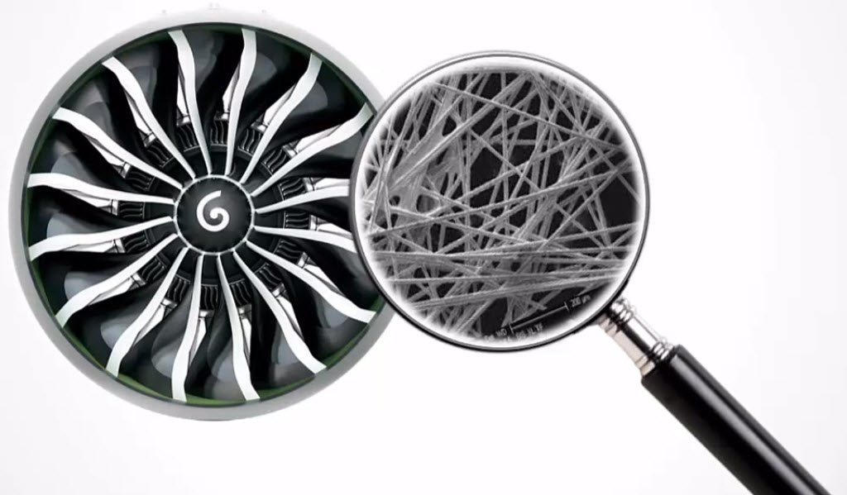
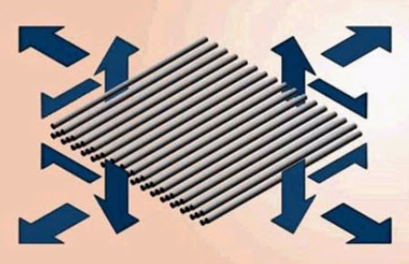
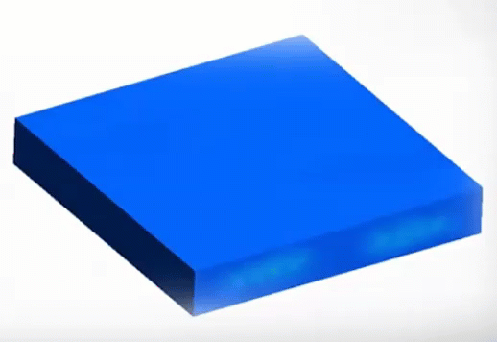
Overview and Motivation
Associate Professorship of Computational Mechanics and Professorship of Wood Technology
Department of Civil, Geo and Environmental Engineering
Technical University of Munich
However….
Complex microstructure
Complex mechanical behavior
Extensive testing required
Simulate more….
Reduce extensive testing cost
In context of failure analysis, answer basic questions:
When does failure start and what happens beyond that ?
How far is final failure from initial one ?
- How is the stress re-distributed ?
(Maya HTT,2015)
(Maya HTT,2015)
(Maya HTT,2015)

Slide 5
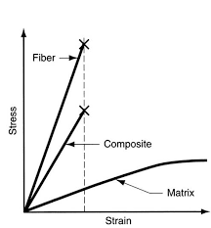
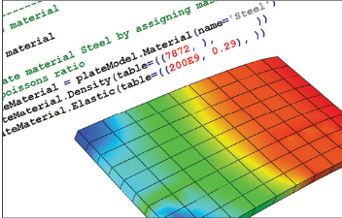

Overview and Motivation
Associate Professorship of Computational Mechanics and Professorship of Wood Technology
Department of Civil, Geo and Environmental Engineering
Technical University of Munich
In FEA…
Material model is required to represent the process
Commercial codes have some built-in models, but:
- Not fully representative for composite materials behavior
- Support for shell elements only (i.e. plane stress/strain)
Develop a user-defined material…
User-subroutines in FE-packages (e.g. UMAT/VUMAT in ABAQUS)
FORTRAN based development interface
Support Implicit/Explicit FEM analysis
Great deal of calibration work
(Alexander,2016)
(Puri,2011)

Slide 6
Associate Professorship of Computational Mechanics and Professorship of Wood Technology
Department of Civil, Geo and Environmental Engineering
Technical University of Munich
Overview and Motivation
Development of UMAT
UMAT Scheme Implementation
UMAT Application Example
Current Progress and Future Timeline
Software Lab Project 2019 | Development of Failure Criteria for Composites | 2nd Review
6

Slide 7
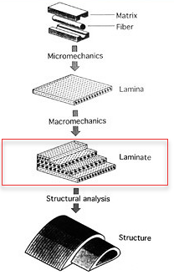
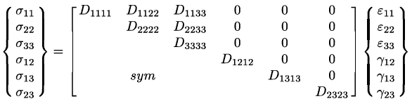
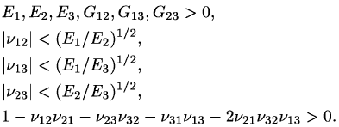
Associate Professorship of Computational Mechanics and Professorship of Wood Technology
Department of Civil, Geo and Environmental Engineering
Technical University of Munich
Development of UMAT
1. Constitutive Law:
Orthotropic elasticity in 3D
Defines linear elastic behavior
Constitutive matrix to satisfy stability requirements
(ABAQUS Manual 2003)
(Kaw,2005)

Slide 8
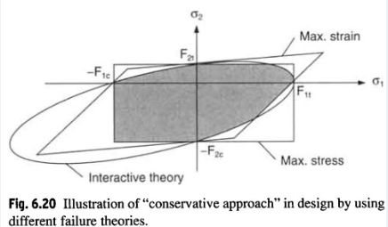
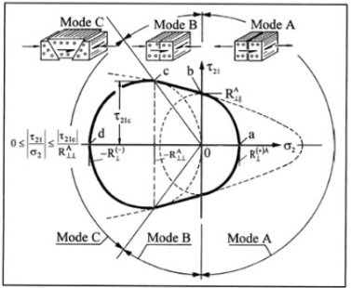
Associate Professorship of Computational Mechanics and Professorship of Wood Technology
Department of Civil, Geo and Environmental Engineering
Technical University of Munich
Development of UMAT
(Daniel,1994)
2. Failure Initiation Criteria:
Limit Value :
Maximum Stress
Maximum Strain
Interactive:
Tsai-Wu
Single Mode :
Hashin
Hoffman
Puck
And many others….
(Daniel,1994)

Slide 9
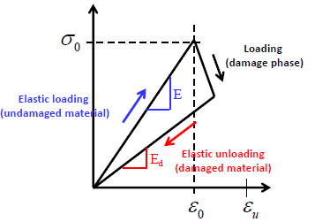
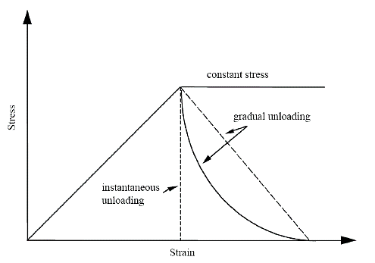
Associate Professorship of Computational Mechanics and Professorship of Wood Technology
Department of Civil, Geo and Environmental Engineering
Technical University of Munich
Development of UMAT
3. Damage Evolution Law:
Upon failure, elastic properties are scaled down
Degradation is selective and can be:
Immediate:
- Set the respective material moduli to small value
(residual stiffness factor, 1-2% of original value)
Gradual:
- Incremental stiffness degradation
- Select damage propagation model
Choice is dictated by material behavior
(ETH Zurich,2015)
(GÜNEL,2012)

Slide 10
Associate Professorship of Computational Mechanics and Professorship of Wood Technology
Department of Civil, Geo and Environmental Engineering
Technical University of Munich
Overview and Motivation
Development of UMAT
UMAT Scheme Implementation
UMAT Application Example
Current Progress and Future Timeline
Software Lab Project 2019 | Development of Failure Criteria for Composites | 2nd Review
10

Slide 11
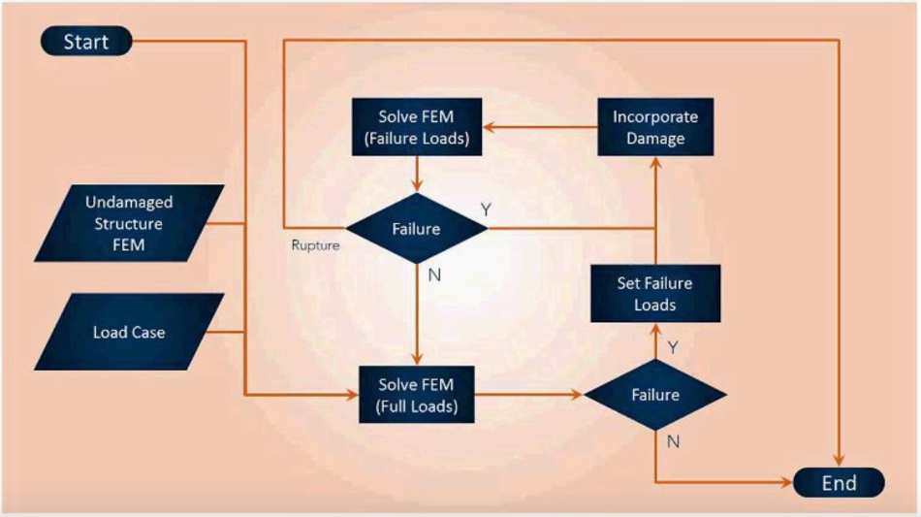
Associate Professorship of Computational Mechanics and Professorship of Wood Technology
Department of Civil, Geo and Environmental Engineering
Technical University of Munich
Development of UMAT
Simulation Loop
(MAYA HTT,2015)

Slide 12
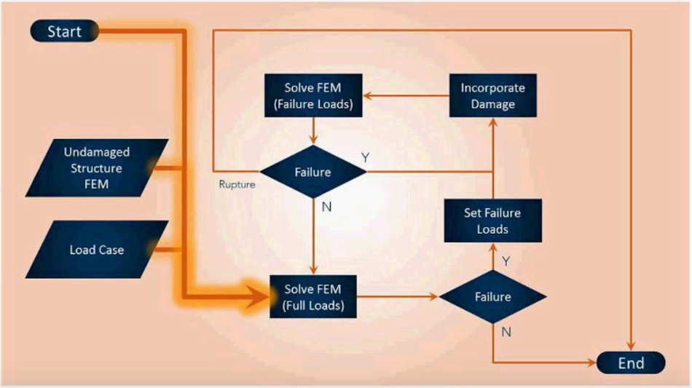
Associate Professorship of Computational Mechanics and Professorship of Wood Technology
Department of Civil, Geo and Environmental Engineering
Technical University of Munich
Development of UMAT
Simulation Loop
(MAYA HTT,2015)

Slide 13
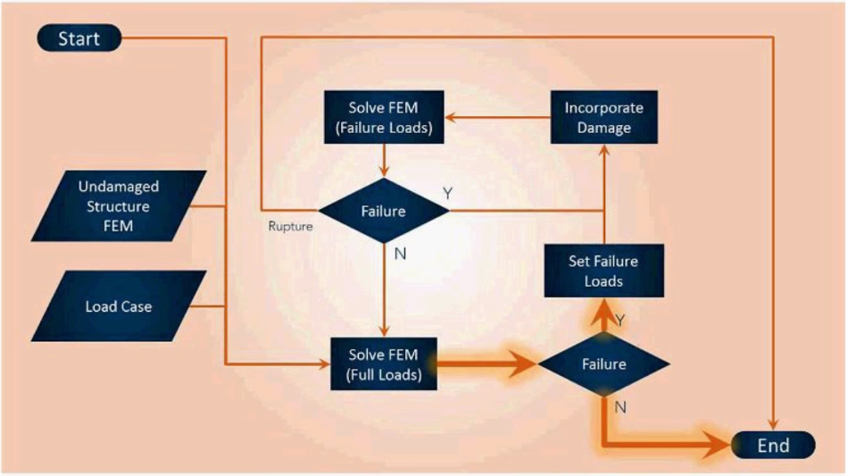
Associate Professorship of Computational Mechanics and Professorship of Wood Technology
Department of Civil, Geo and Environmental Engineering
Technical University of Munich
Development of UMAT
Simulation Loop
(MAYA HTT,2015)

Slide 14
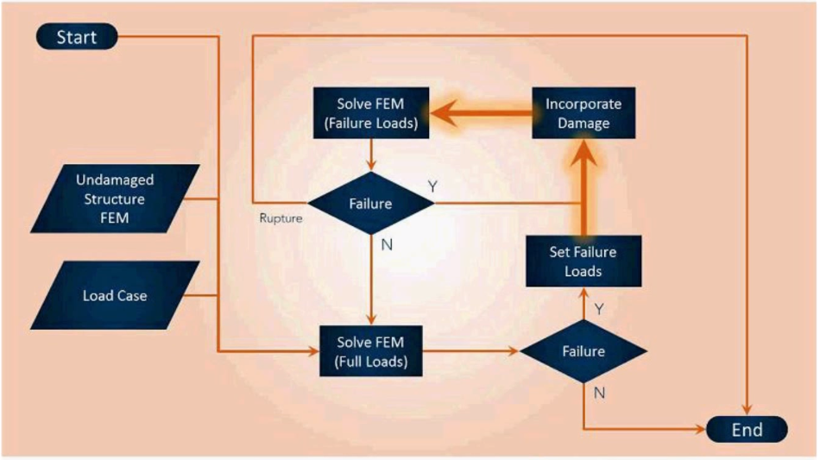
Associate Professorship of Computational Mechanics and Professorship of Wood Technology
Department of Civil, Geo and Environmental Engineering
Technical University of Munich
Development of UMAT
Simulation Loop
(MAYA HTT,2015)

Slide 15
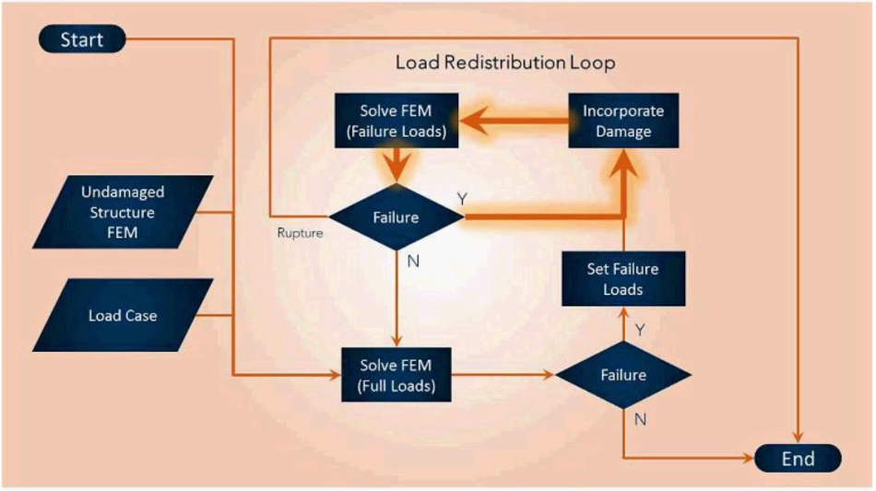
Associate Professorship of Computational Mechanics and Professorship of Wood Technology
Department of Civil, Geo and Environmental Engineering
Technical University of Munich
Development of UMAT
Simulation Loop
(MAYA HTT,2015)

Slide 16
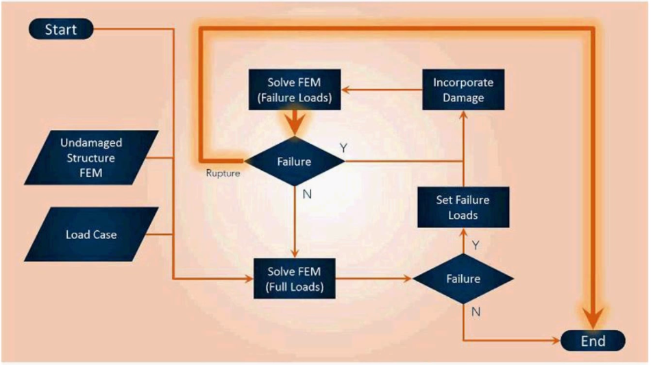
Associate Professorship of Computational Mechanics and Professorship of Wood Technology
Department of Civil, Geo and Environmental Engineering
Technical University of Munich
Development of UMAT
Simulation Loop
(MAYA HTT,2015)

Slide 17
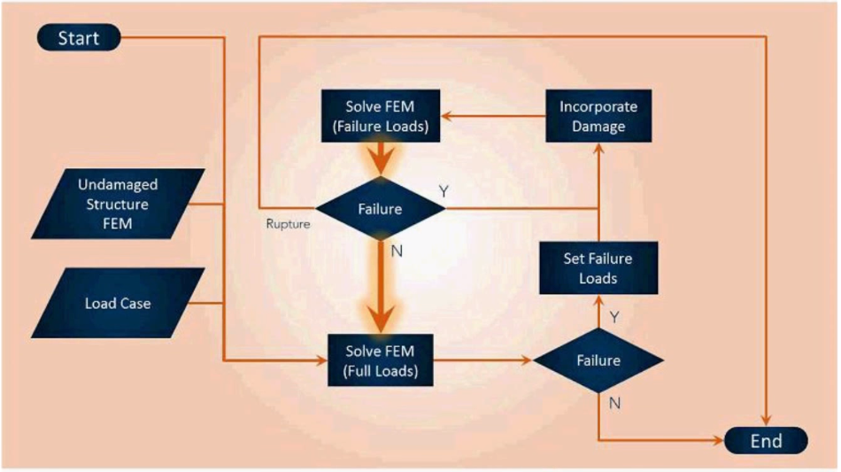
Associate Professorship of Computational Mechanics and Professorship of Wood Technology
Department of Civil, Geo and Environmental Engineering
Technical University of Munich
Development of UMAT
Simulation Loop
(MAYA HTT,2015)

Slide 18
Associate Professorship of Computational Mechanics and Professorship of Wood Technology
Department of Civil, Geo and Environmental Engineering
Technical University of Munich
Overview and Motivation
Development of UMAT
UMAT Scheme Implementation
UMAT Application Example
Current Progress and Future Timeline
Software Lab Project 2019 | Development of Failure Criteria for Composites | 2nd Review
18

Slide 19
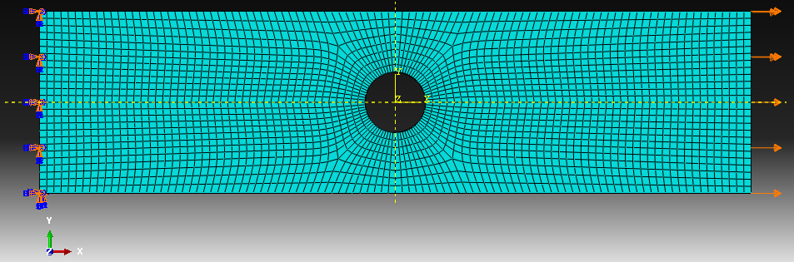
Associate Professorship of Computational Mechanics and Professorship of Wood Technology
Department of Civil, Geo and Environmental Engineering
Technical University of Munich
UMAT Application Example
Tensile Test Coupon
Model Parameters:
-T300/5208 Graphite/epoxy
laminate
-Implicit FEM analysis
-Increment size: 0.01
-Failure Criteria:
Max Stress
Tsai-Wu
Hashin
-Instant Damage
(Model Geometry, Mesh and Boundary Conditions in ABAQUS)
(Pearce,2012)

Slide 20
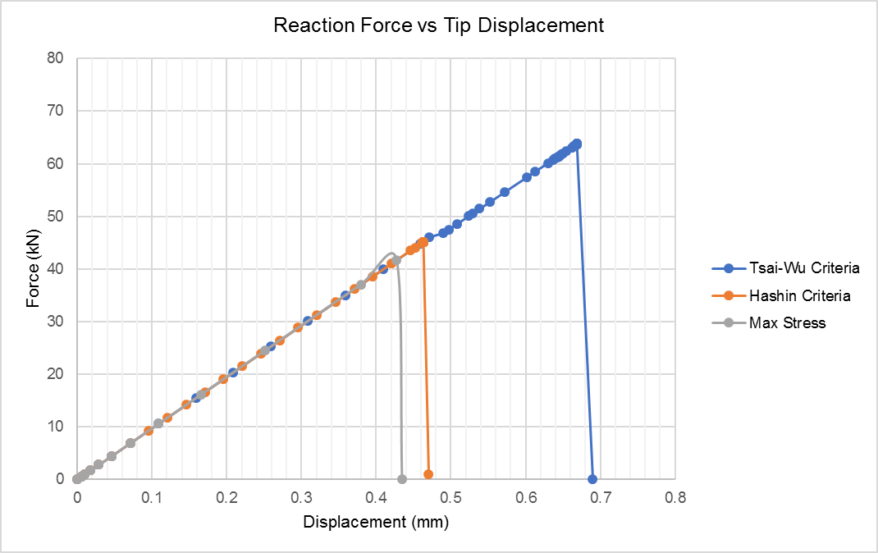
Associate Professorship of Computational Mechanics and Professorship of Wood Technology
Department of Civil, Geo and Environmental Engineering
Technical University of Munich
UMAT Application Example
Tensile Test Coupon
Model Results:
(Predicted failure loads as per different failure criteria)

Slide 21

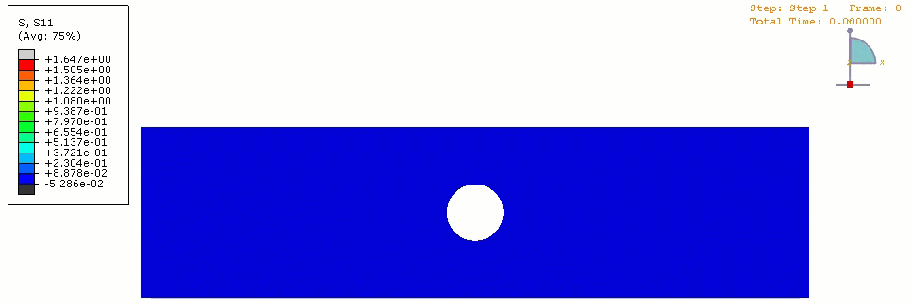
Associate Professorship of Computational Mechanics and Professorship of Wood Technology
Department of Civil, Geo and Environmental Engineering
Technical University of Munich
UMAT Application Example
Tensile Test Coupon
Model Results:
(Fiber Progressive Failure Mode, Hashin Criteria)
(S11 Stress Redistribution, Hashin Criteria )

Slide 22
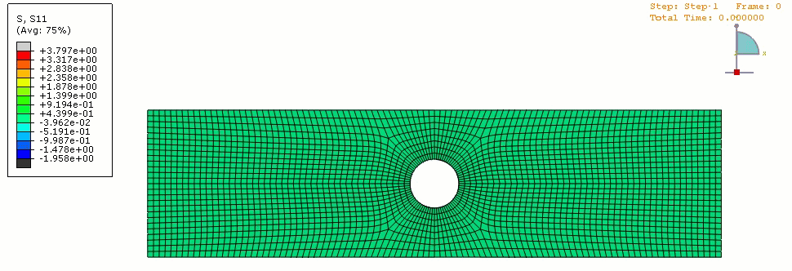
Associate Professorship of Computational Mechanics and Professorship of Wood Technology
Department of Civil, Geo and Environmental Engineering
Technical University of Munich
UMAT Application Example
Tensile Test Coupon
Model Results:
(S11 Stress Distribution With Element deletion, Max Stress Criteria)

Slide 23
Associate Professorship of Computational Mechanics and Professorship of Wood Technology
Department of Civil, Geo and Environmental Engineering
Technical University of Munich
Overview and Motivation
Development of UMAT
UMAT Scheme Implementation
UMAT Application Example
Current Progress and Future Timeline
Software Lab Project 2019 | Development of Failure Criteria for Composites | 2nd Review
23

Slide 24
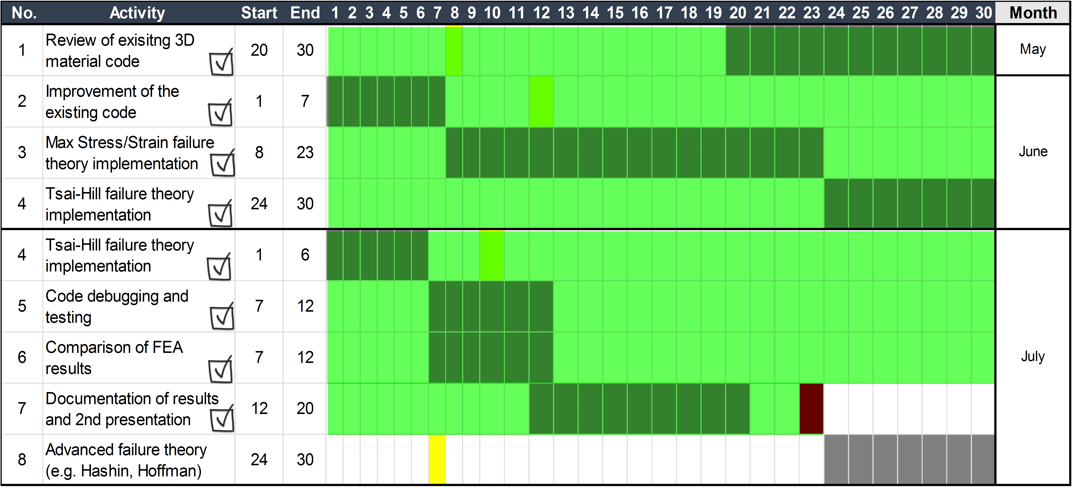
Associate Professorship of Computational Mechanics and Professorship of Wood Technology
Department of Civil, Geo and Environmental Engineering
Technical University of Munich
Current Progress and Future Timeline
Accompliched Activities:

Slide 25
Associate Professorship of Computational Mechanics and Professorship of Wood Technology
Department of Civil, Geo and Environmental Engineering
Technical University of Munich
Current Progress and Future Timeline
Proposed Future time plan as follows :

Slide 26
References
Associate Professorship of Computational Mechanics and Professorship of Wood Technology
Department of Civil, Geo and Environmental Engineering
Technical University of Munich
Kaw, A. K. (2005). Mechanics of composite materials. CRC press.
Carrera, E. (2018). Implementation of classical and advanced failure criteria for composite layered structures in FEMAP and assessment of results (Doctoral dissertation, Politecnico di Torino).
ATAR, M. B. (2016). EXPERIMENTAL AND NUMERICAL FAILURE ANALYSIS OF ADVANCED COMPOSITE STRUCTURES WITH HOLES (Doctoral dissertation, MIDDLE EAST TECHNICAL UNIVERSITY).
Berger, A. (2014). Numerical Modelling of Composite Materials Based on a Combined Manufacturing-Crash Simulation(Doctoral dissertation, Queen Mary University of London).
Abaqus, U. S. M., & Manuals, E. U. S. (2002). Version 6.3, Hibbitt, Karlsson & Sorensen. Inc. Rhode Island.

Slide 27
References
Associate Professorship of Computational Mechanics and Professorship of Wood Technology
Department of Civil, Geo and Environmental Engineering
Technical University of Munich
3ds.com. (2019). Writing User Subroutines with Abaqus. [online] Available at: https://www.3ds.com/products-services/simulia/services/training-courses/course-descriptions/writing-user-subroutines-with-abaqus/ [Accessed 17 May 2019].
Systèmes, D. (2010). Abaqus 6.10 online documentation. Abaqus User Subroutines Reference Manual.
Maya, H. T. T. (2012). NX thermal.
Knight Jr, N. F., & Reeder, J. R. (2006). User-defined material model for progressive failure analysis.
Larry Pearce, Sr.Lead application engineer, MSC Software, ʻʻProgressive ply failure in composites,ʼʼ Webinar on May 15, 2012

Slide 28

Questions ?
Associate Professorship of Computational Mechanics and Professorship of Wood Technology
Department of Civil, Geo and Environmental Engineering
Technical University of Munich

Slide 29
Backup Slides
Associate Professorship of Computational Mechanics and Professorship of Wood Technology
Department of Civil, Geo and Environmental Engineering
Technical University of Munich

Slide 30
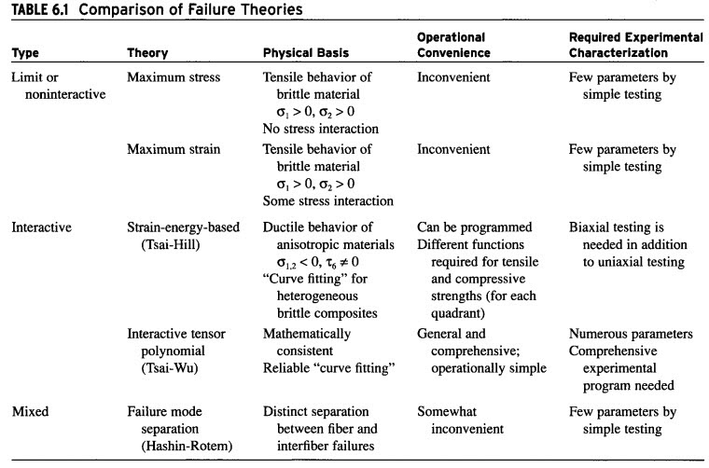
Comparison:
Associate Professorship of Computational Mechanics and Professorship of Wood Technology
Department of Civil, Geo and Environmental Engineering
Technical University of Munich

Slide 31
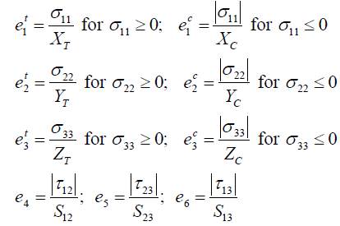
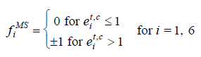
Max Stress Theory
Associate Professorship of Computational Mechanics and Professorship of Wood Technology
Department of Civil, Geo and Environmental Engineering
Technical University of Munich
State Variables and Failure Index:

Slide 32
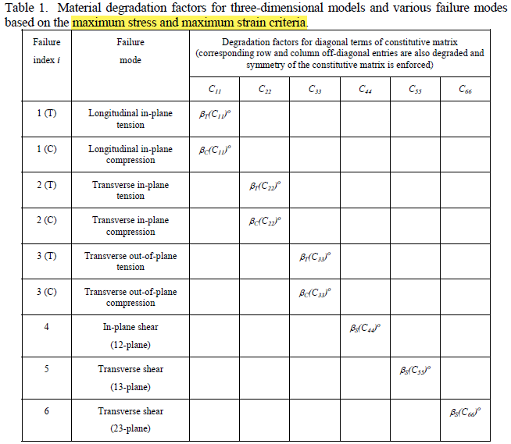
Damage Development
Associate Professorship of Computational Mechanics and Professorship of Wood Technology
Department of Civil, Geo and Environmental Engineering
Technical University of Munich

Slide 33
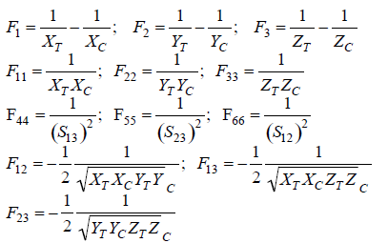
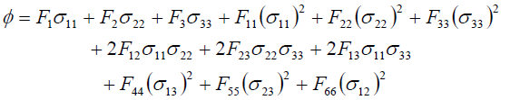
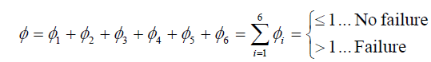
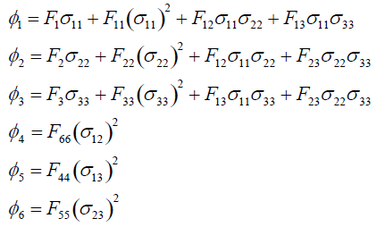
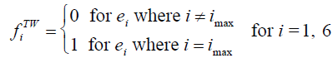
Tsai-Wu Theory
Associate Professorship of Computational Mechanics and Professorship of Wood Technology
Department of Civil, Geo and Environmental Engineering
Technical University of Munich
State Variables and Failure Index:

Slide 34
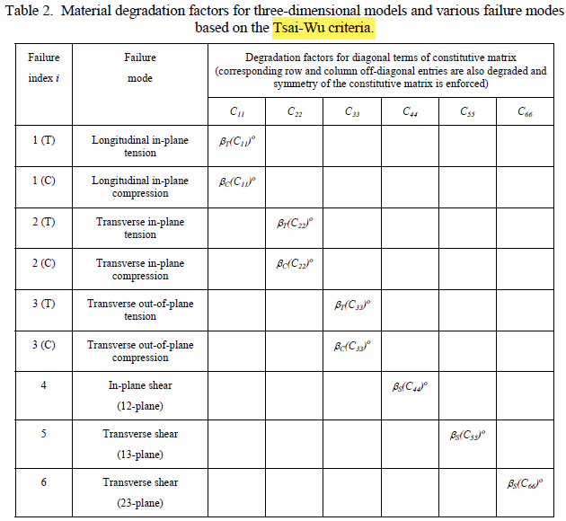
Damage Development
Associate Professorship of Computational Mechanics and Professorship of Wood Technology
Department of Civil, Geo and Environmental Engineering
Technical University of Munich

Slide 35
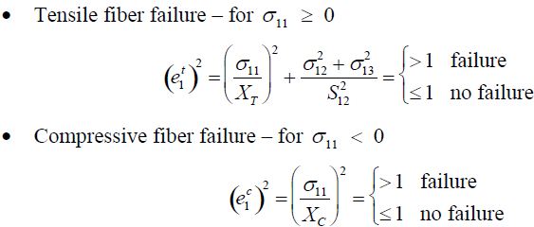
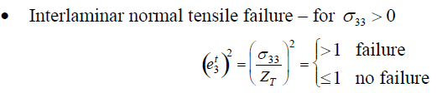
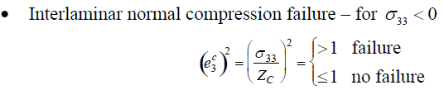
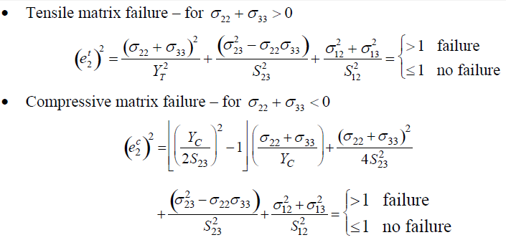
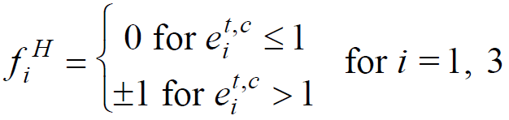
Hashin Theory
Associate Professorship of Computational Mechanics and Professorship of Wood Technology
Department of Civil, Geo and Environmental Engineering
Technical University of Munich
State Variables and Failure Index:

Slide 36
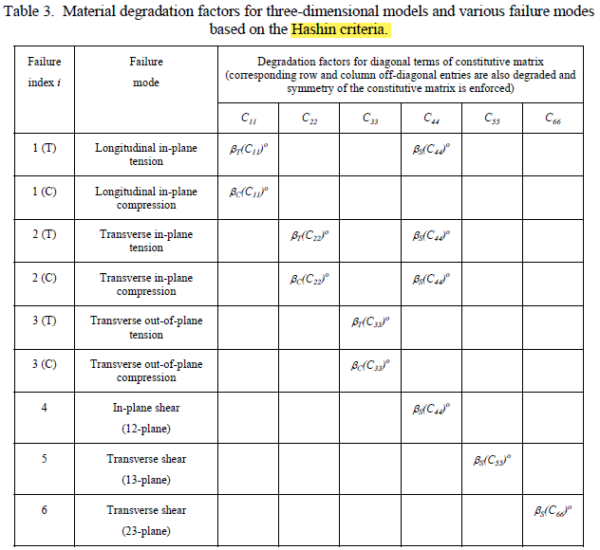
Damage Development
Associate Professorship of Computational Mechanics and Professorship of Wood Technology
Department of Civil, Geo and Environmental Engineering
Technical University of Munich

Slide 37
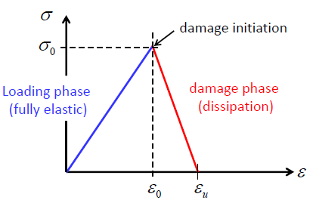
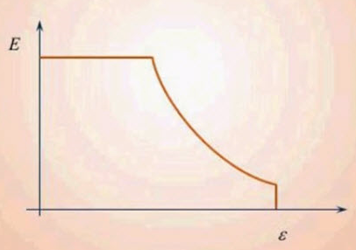
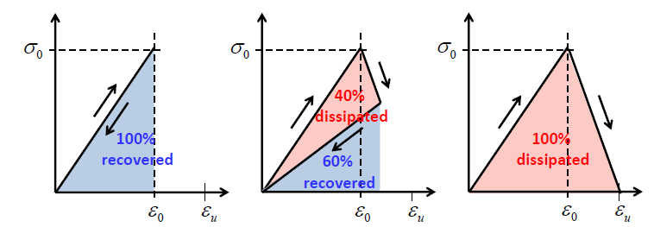
Damage Development
Associate Professorship of Computational Mechanics and Professorship of Wood Technology
Department of Civil, Geo and Environmental Engineering
Technical University of Munich

Slide 38

Damage Development
Associate Professorship of Computational Mechanics and Professorship of Wood Technology
Department of Civil, Geo and Environmental Engineering
Technical University of Munich

Slide 39


Homogenization vs MCT :
Associate Professorship of Computational Mechanics and Professorship of Wood Technology
Department of Civil, Geo and Environmental Engineering
Technical University of Munich

Slide 40

Macro to Micro Scale:
Associate Professorship of Computational Mechanics and Professorship of Wood Technology
Department of Civil, Geo and Environmental Engineering
Technical University of Munich

Slide 41

UMAT Micro Scale :
Associate Professorship of Computational Mechanics and Professorship of Wood Technology
Department of Civil, Geo and Environmental Engineering
Technical University of Munich

Slide 42

Progressive Failure Analysis:
Associate Professorship of Computational Mechanics and Professorship of Wood Technology
Department of Civil, Geo and Environmental Engineering
Technical University of Munich

Slide 43

UMAT Loop:
Associate Professorship of Computational Mechanics and Professorship of Wood Technology
Department of Civil, Geo and Environmental Engineering
Technical University of Munich

Slide 44

VUMAT Loop:
Associate Professorship of Computational Mechanics and Professorship of Wood Technology
Department of Civil, Geo and Environmental Engineering
Technical University of Munich

Slide 45

ABAQUS/UMAT Implementation:
Associate Professorship of Computational Mechanics and Professorship of Wood Technology
Department of Civil, Geo and Environmental Engineering
Technical University of Munich

